Slide 1
Specification of Tokens
Regular expressions are an important notation for specifying lexeme patterns
An alphabet is a finite set of symbols.
Typical example of symbols are letters, digits and punctuation etc.
The set {0, 1} is the binary alphabet.
A string over an alphabet is a finite sequence of symbols drawn from that alphabet.
The length is string s is denoted as |s|
Empty string is denoted by ε
Prefix: ban, banana, ε, etc are the prefixes of banana
Suffix: nana, banana, ε, etc are suffixes of banana
Kleene or closure of a language L, denoted by L*.
L*: concatenation of L zero or more times
L⁰: concatenation of L zero times
L⁺: concatenation of L one or more times

Slide 2
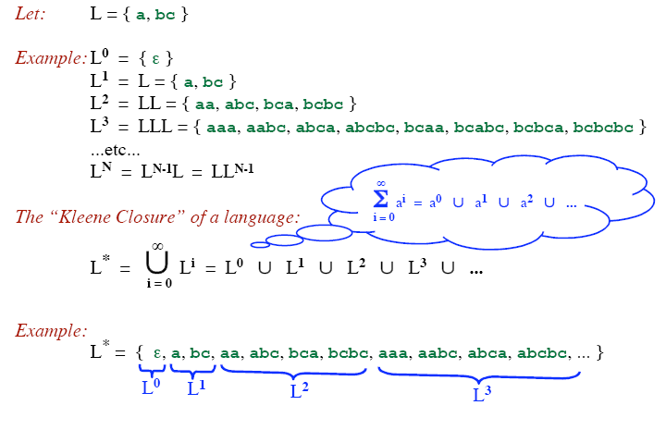
Kleene closure
L* denotes “zero or more concatenations of” L

Slide 3
Example
Let: L = { a, b, c, ..., z }
D = { 0, 1, 2, ..., 9 }
D⁺ = “The set of strings with one or more digits”
L ∪ D = “The set of all letters and digits (alphanumeric characters)”
LD = “The set of strings consisting of a letter followed by a digit”
L* = “The set of all strings of letters, including ε, the empty string”
( L ∪ D )* = “Sequences of zero or more letters and digits”
L ( ( L ∪ D )* ) = “Set of strings that start with a letter, followed by zero or more letters and digits.”

Slide 4
Rules for specifying Regular Expressions
Regular expressions over alphabet ∑
ε is a regular expression that denotes {ε}.
If a is a symbol (i.e., if a∈ ∑), then a is a regular expression that denotes {a}.
Suppose r and s are regular expressions denoting the languages L(r) and L(s). Then
(r) | (s) is a regular expression denoting L(r) U L(s).
(r)(s) is a regular expression denoting L(r)L(s).
(r)* is a regular expression denoting (L(r))*.
(r) is a regular expression denoting L(r).

Slide 5
How to “Parse” Regular Expressions
Precedence:
* has highest precedence.
Concatenation as middle precedence.
| has lowest precedence.
Use parentheses to override these rules.
Examples:
a b* = a (b*)
If you want (a b)* you must use parentheses.
a | b c = a | (b c)
If you want (a | b) c you must use parentheses.
Concatenation and | are associative.
(a b) c = a (b c) = a b c
(a | b) | c = a | (b | c) = a | b | c
Example:
b d | e f * | g a = (b d) | (e (f *)) | (g a)

Slide 6
Example
Let Σ = {a, b}
The regular expression a | b denotes the set {a, b}
The regular expression (a|b)(a|b) denotes {aa, ab, ba, bb}
The regular expression a* denotes the set of all strings of zero or more a’s. i.e., {ε, a, aa, aaa, ….. }
The regular expression (a|b)* denotes the set containing zero or more instances of an a or b.
The regular expression a|a*b denotes the set containing the string a and all strings consisting of zero or more a’s followed by one b.

Slide 7
Regular Definition
If Σ is an alphabet of basic symbols then a regular definition is a sequence of the following form:
d₁→r₁
d₂→r₂
……..
d_{n}→r_{n}
where
Each d_{i} is a new symbol such that d_{i} ∉ Σ and d_{i} ≠d_{j} where j < I
Each r_{i} is a regular expression over Σ ∪ {d₁,d₂,…,d_{i-1})

Slide 8
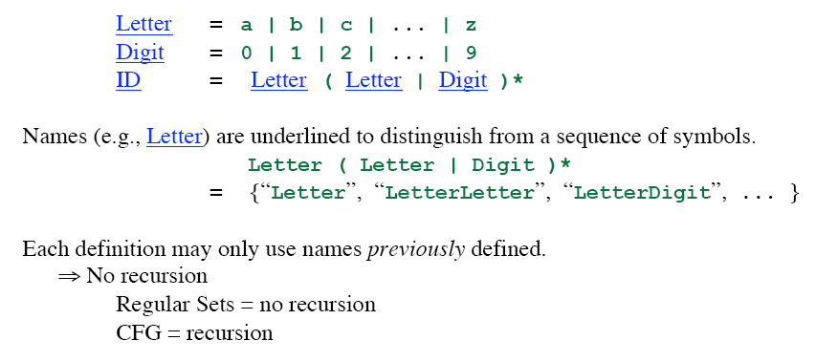
Regular Definition

Slide 9
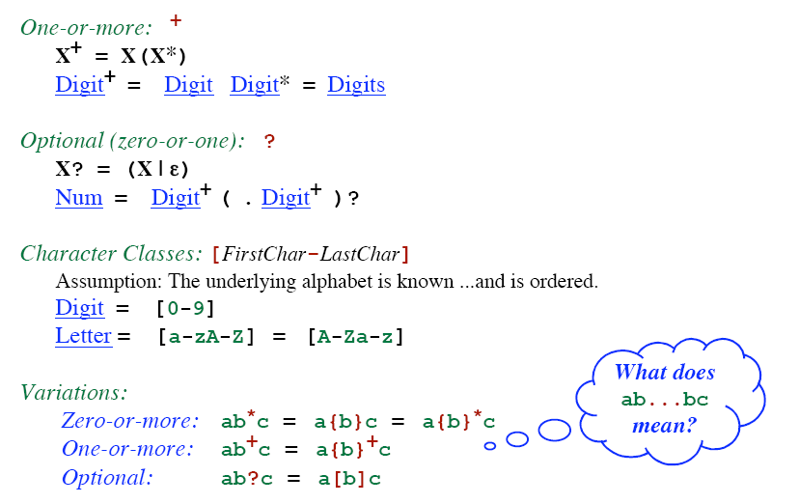
Addition Notation / Shorthand

Slide 10
Unsigned Number
1240, 39.45, 6.33E15, or 1.578E-41
digit → 0 | 1 | 2 | … | 9
digits → digit digit*
optional_fraction → . digits | ∈
optional_exponent → ( E ( + | -| ∈) digits) | ∈
num → digits optional_fraction optional_exponent
Shorthand
digit → 0 | 1 | 2 | … | 9
digits → digit⁺
optional_fraction → (. digits ) ?
optional_exponent → ( E ( + | -) ? digits) ?
num → digits optional_fraction optional_exponent

Slide 11
Some Other Examples
Telephone numbers of the form
(937)-775-5134
exchange = digit³
phone = digit⁴
area = digit³
phone_number = '(' area ')-' exchange '-' phone
Email address
violin@cs.wright.edu
??

Slide 12
Token Recognition
How can we use concepts developed so far to assist in recognizing tokens of a source language ?
Assume Following Tokens:
if, then, else, relop, id, num
Given Tokens, What are Patterns ?
Grammar: stmt → |if expr then stmt |if expr then stmt else stmt |∈ expr → term relop term | term term → id | num
if → if
then → then
else → else
relop → < | <= | > | >= | = | <>
id → letter ( letter | digit )*
num → digit ⁺ (. digit ⁺ ) ? ( E(+ | -) ? digit ⁺ ) ?

Slide 13
What Else Does Lexical Analyzer Do?
Scan away blanks, new lines, tabs
Can we Define Tokens For These?
blank → blank
tab → tab
newline → newline
delim → blank | tab | newline
ws → delim ⁺
In these cases no token is returned to parser

Slide 14
Overall
Regular Expression
Token
Attribute-Value
ws
if
then
else
id
num
<
<=
=
< >
>
>=
-
if
then
else
id
num
relop
relop
relop
relop
relop
relop
-
-
-
-
pointer to table entry
Exact value
LT
LE
EQ
NE
GT
GE
Note: Each token has a unique token identifier to define category of lexemes

Slide 15
Constructing Transition Diagrams for Tokens
Transition Diagrams (TD) are used to represent the tokens
As characters are read, the relevant TDs are used to attempt to match lexeme to a pattern
Each TD has:
States : Represented by Circles
Actions : Represented by Arrows between states
Start State : Beginning of a pattern (Arrowhead)
Final State(s) : End of pattern (Concentric Circles)
Edges: arrows connecting the states
Each TD is Deterministic (assume) - No need to choose between 2 different actions !

Slide 16
Example TDs
> = :
start
>
=
RTN(GE)
0
6
7
other
*
RTN(GT)
8
We’ve accepted “>” and have read one extra char that must be unread.

Slide 17
Example : All RELOPs
start
<
=
0
1
2
return(relop, LE)
>
3
return(relop, NE)
other
*
=
4
return(relop, LT)
5
return(relop, EQ)
>
=
6
7
return(relop, GE)
other
*
8
return(relop, GT)

Slide 18
Example TDs : id and delim
id :
letter or digit
start
letter
other
*
9
10
11
return( get_token(), install_id())
Either returns ptr or “0” if reserved
delim :
delim
start
delim
other
*
28
29
30

Slide 19
Example TDs : Unsigned #s
digit
digit
digit
start
digit
.
digit
E
+ | -
digit
other
*
12
13
14
15
16
17
18
19
E
digit
digit
digit
start
digit
*
.
digit
other
*
20
21
22
23
24
return(num, install_num())
digit
start
digit
other
*
25
26
27
Questions: Is ordering important for unsigned #s ?
Why are there no TDs for then, else, if ?

Slide 20
QUESTION :
What would the transition diagram (TD) for strings containing each vowel, in their strict lexicographical order, look like?

Slide 21
Answer
cons → B | C | D | F | G | H | J | … | N | P | … | T | V | .. | Z
string → cons* A cons* E cons* I cons* O cons* U cons*
cons
cons
cons
cons
cons
cons
start
A
E
I
O
U
other
accept
error
Note: The error path is taken if the character is other than a cons or the vowel in the lex order.

Slide 22
Capturing Multiple Tokens
Capturing keyword “begin”
start
b
e
g
i
n
WS
WS – white space
A – alphabetic
AN – alphanumeric
Capturing variable names
start
A
WS
AN
What if both need to happen at the same time?

Slide 23
Capturing Multiple Tokens
start
b
e
g
i
n
WS
A-b
AN
WS – white space
A – alphabetic
AN – alphanumeric
AN
WS
Machine is much more complicated – just for these two tokens!

Slide 24
Finite State Automata (FSAs)
“Finite State Machines”, “Finite Automata”, “FA”
A recognizer for a language is a program that takes as input a string x and answers “yes” if x is a sentence of the language and “no” otherwise.
The regular expression is compiled into a recognizer by constructing a generalized transition diagram called a finite automaton.
Each state is labeled with a state name
Directed edges, labeled with symbols
Two types
Deterministic (DFA)
Non-deterministic (NFA)

Slide 25
Nondeterministic Finite Automata
A nondeterministic finite automaton (NFA) is a mathematical model that consists of
A set of states S
A set of input symbols Σ
A transition function that maps state/symbol pairs to a set of states
A special state s₀ called the start state
A set of states F (subset of S) of final states
INPUT: string
OUTPUT: yes or no

Slide 26
Example – NFA : (a|b)*abb
S = { 0, 1, 2, 3 }
s₀ = 0
F = { 3 }
Σ = { a, b }
a
start
0
a
1
b
2
b
3
b
i n p u t
∈ (null) moves possible
a
b
state
0
{ 0, 1 }
{ 0 }
i
∈
j
1
--
{ 2 }
Switch state but do not use any input symbol
2
--
{ 3 }
Transition Table

Slide 27
How Does An NFA Work ?
a
start
0
a
1
b
2
b
3
b
Given an input string, we trace moves
If no more input & in final state, ACCEPT
EXAMPLE: Input: ababb
-OR-
move(0, a) = 0
move(0, b) = 0
move(0, a) = 1
move(1, b) = 2
move(2, b) = 3
ACCEPT !
move(0, a) = 1
move(1, b) = 2
move(2, a) = ? (undefined)
REJECT !

Slide 28
Handling Undefined Transitions
We can handle undefined transitions by defining one more state, a “death” state, and transitioning all previously undefined transition to this death state.
a
start
0
a
1
b
2
b
3
b
a
a
a, b
4
Σ

Slide 29
Other Concepts
Not all paths may result in acceptance.
a
start
0
a
1
b
2
b
3
b
aabb is accepted along path : 0 → 0 → 1 → 2 → 3
BUT… it is not accepted along the valid path:
0 → 0 → 0 → 0 → 0

Slide 30
Deterministic Finite Automata
A DFA is an NFA with the following restrictions:
∈ moves are not allowed
For every state s ∈S, there is one and only one path from s for every input symbol a ∈ Σ.
Since transition tables don’t have any alternative options, DFAs are easily simulated via an algorithm.
s ← s₀
c ← nextchar;
while c ≠ eof do
s ← move(s,c);
c ← nextchar;
end;
if s is in F then return “yes”
else return “no”

Slide 31
Example – DFA : (a|b)*abb
b
a
start
0
a
1
b
2
b
3
a
b
a
What Language is Accepted?
Recall the original NFA:
a
start
0
a
1
b
2
b
3
b

Slide 32
Relation between RE, NFA and DFA
There is an algorithm for converting any RE into an NFA.
There is an algorithm for converting any NFA to a DFA.
There is an algorithm for converting any DFA to a RE.
These facts tell us that REs, NFAs and DFAs have equivalent expressive power.
All three describe the class of regular languages.

Slide 33
NFA vs DFA
An NFA may be simulated by algorithm, when NFA is constructed from the R.E
Algorithm run time is proportional to |N| * |x| where |N| is the number of states and |x| is the length of input
Alternatively, we can construct DFA from NFA and uses it to recognize input
The space requirement of a DFA can be large. The RE (a+b)*a(a+b)(a+b)….(a+b) [n-1 (a+b) at the end] has no DFA with less than 2^{n} states. Fortunately, such RE in practice does not occur often
space required
time to simulate
NFA
O(|r|)
O(|r|*|x|)
DFA
O(2^{|r|})
O(|x|)
where |r| is the length of the regular expression.

Slide 34
Thank You
Any Questions?

